Slide 1

E-commerce: the road to extinction?

Slide 2

Today:
3 – 2 – 1
2

Slide 3

3 key challenges
Ensuring the packaging is up to the job
Developing cost out initiatives that are also sustainable
Delighting the shopper in the home
2

Slide 4

Challenge # 1: Packaging that is up to the job
50 touchpoints in typical product journey
Risk of damage to either the box or its contents is high
Shoppers can feel
  deflated
  angry
  upset
  worried
about their online deliveries
Packaging must also survive the return journey
Consider packaging at the start of product development journey, and ensure it is robust
Notes:
When a package arrives through the post, it is the first point of physical contact with any new purchase.
Shoppers can feel deflated without the multi-layered in-store experience, or angry or upset if product arrives broken or worried about recycling the excessive packaging it has arrived in
Vital to consider packaging at the very beginning of product development journey

Slide 5

Challenge # 2: Packaging that is sustainable
85% of shoppers would pay a premium for sustainably packaged goods
32% of shoppers are concerned by excess packaging
Optimum material and voidfill should be packaging priorities
Zero waste from packaging is becoming a reality
More sustainable packaging can also mean reduced shipping and transport costs
4
Notes:
85% of European shoppers would be prepared to pay a premium for sustainably packaged goods. On average they would be willing to pay 12% more (Source: STI Group)
39% of shoppers who have bought something online are concerned by excess packaging, while 15% worry about how to recycle packaging.
A more sustainable approach is now a business imperative.
Fortunately, zero waste from packaging is now a reality

Slide 6

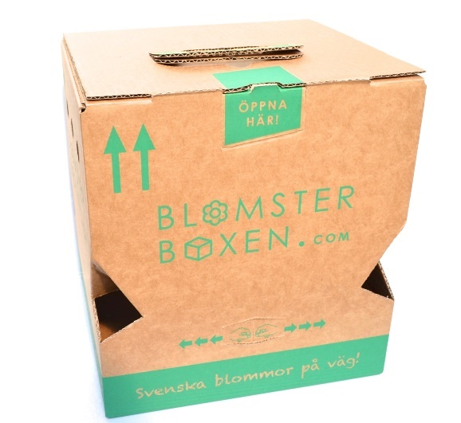

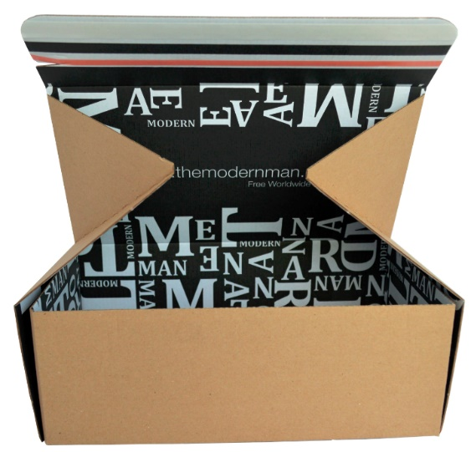
Challenge # 3: Packaging that delights
Extend brand messaging into the home
Unwrapping experience – moment of ‘home theatre’
Advances in digital print techniques
Packaging design – increasingly innovative new shapes and ideas
6
Notes:
Packaging as a way of replacing the shop floor experience and extending brand messaging into the home.
Unwrapping experience – moment of ‘home theatre.’ (Particularly important for millennial generation, for whom the unboxing experience is something to celebrate and share on social media)
Advancements in digital print techniques = highest quality, image fidelity and consistency of print. Brands can customise the look and feel of their packaging, even to tie in with multichannel advertising campaigns.
Packaging design – increasingly innovative new shapes and ideas

Slide 7
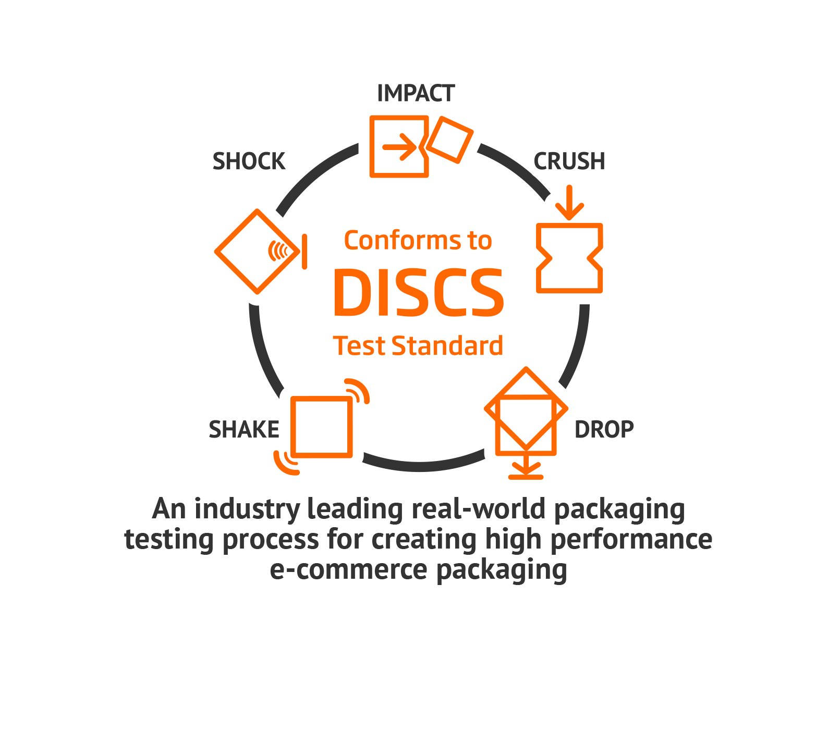
Innovative solution # 1: DISCS
Drop
Impact
Shock
Crush
Shake
Benefits:
Reduced risk of damage and returns
Optimum material usage
Reduced voidfill
Reduced shipping costs
3
Notes:
DISCS – named after the different types of testing (Drop Impact Shock Crush Shake)
Five pieces of equipment, each replicating a part of the e-commerce product journey and therefore providing real world testing
Online orders have up to 50 touch points, so packaging must be able to withstand these stresses and strains
Could revolutionise industry and provide vital assurance to customers that their products will be protected no matter what

Slide 8
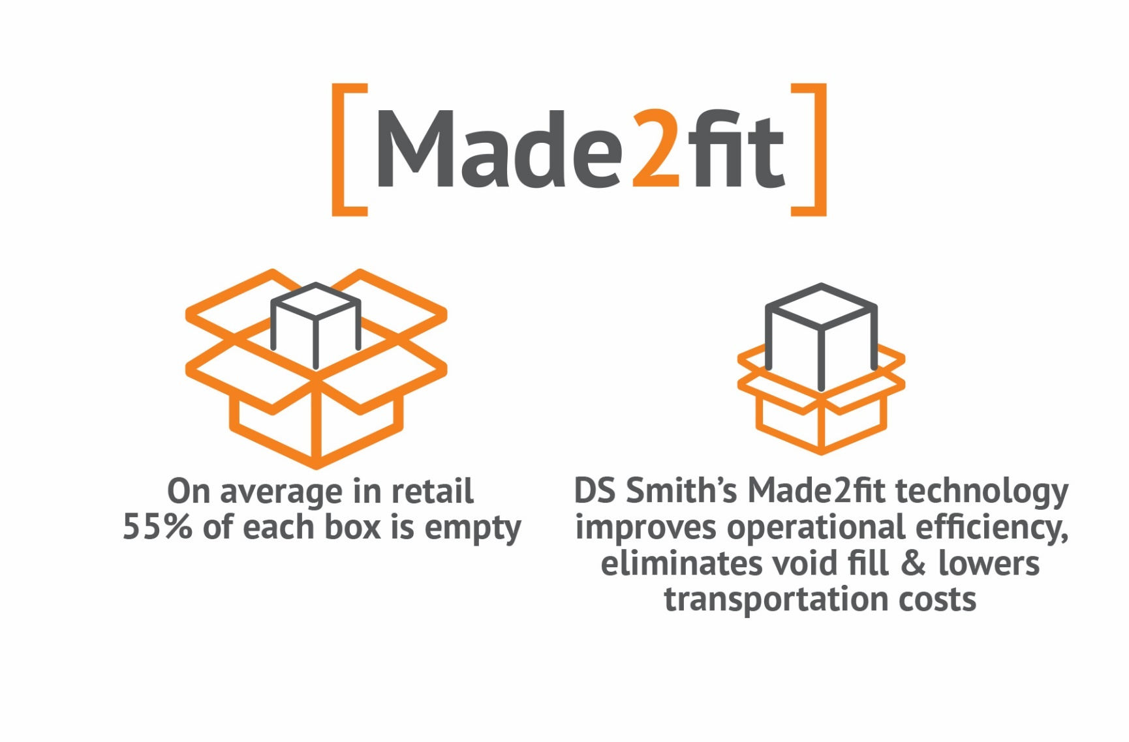
Innovative solution # 2: Made2fit
Made2fit – new technology that creates right size packaging
Two versions - manual and automated
Manual – for lower volume orders – 39 possible combinations
Automated – larger volume orders – 10 million combinations
5
Notes:
cMade2fit –new technology that creates right size packaging
Eliminates void space
Reduces product movement and therefore reduces damage
Reduces excess packaging
Saves warehouse space
Cuts assembly and packing times
Manual Made2fit solution for lower volume orders, creating 39 possible box size combinations from just three blank sizes
Automated Made2fit for larger volume orders, with the capability to manufacture more than 10 million box size combinations, in a process that is omnichannel ready.

Slide 9

One big vision
Ecommerce will become extinct; omnichannel the future
Shoppers want impactful, in-store experiences replicated in their e-commerce interactions
DS Smith is preparing now for omnichannel world
7
Notes:
DS Smith is preparing now for omnichannel world – a world where digital technology, drones, automated warehouses and driverless vehicles are the norm
New technology such as Made2fit is just the start …

Slide 10
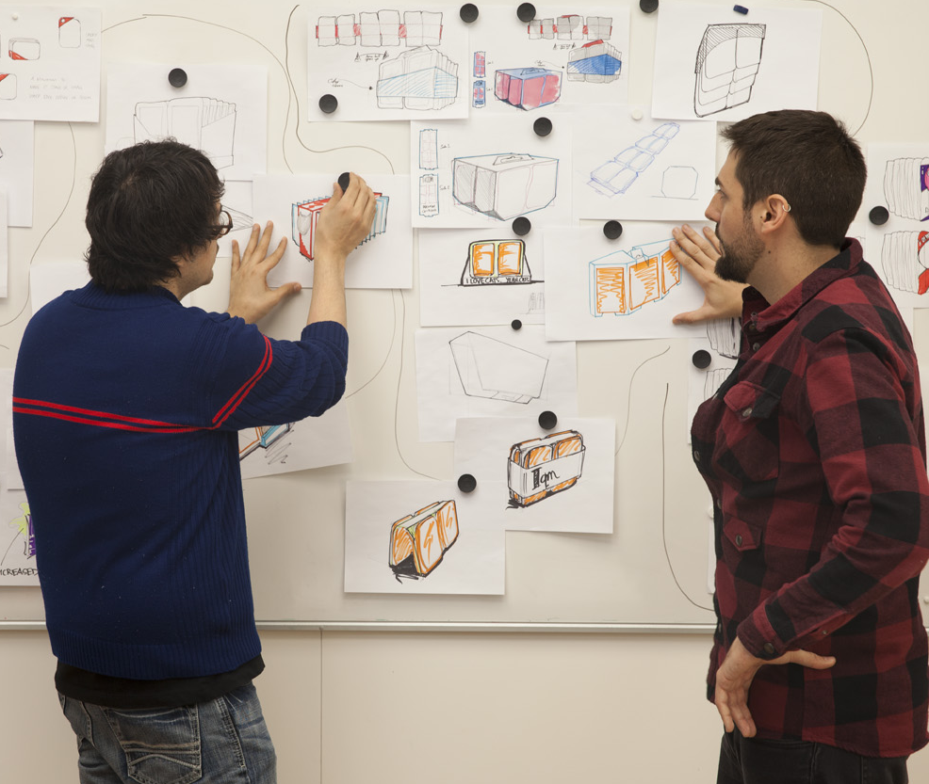
Thanks
www.dssmith.com/ecommerce
5

